Slide 1
OWASP TOP 10
A03:2021 – Injection

Slide 2
DESCRIPTION
User input is not properly sanitized or validated, allowing an attacker to inject malicious code into an application.
Common types of injection attacks include SQL injection and command injection.
Consequences, such as data theft, data manipulation, and unauthorized access to sensitive information.

Slide 3
EXAMPLES
SQL Injection: Web application where the users to search for products by name. It does not properly sanitize user input before passing it to the database. An attacker could input the following into the search field:
' OR 1=1—
A web application that allows users to ping a website to check its availability. It does not properly validate user input before executing the ping command. An attacker could input the following command into the ping field:
127.0.0.1; ls -la

Slide 4

How to prevent?
Don’t Run System Commands with User-Supplied Input.
os.system(“listdir <directory-path>”) os.listdir(“<directory-path>”)
Use Strong Input Validation for Input Passed into Commands.
Ls and pwd ^[a-z0–9]{1,10}$
& | ; $ > < ` \ !
Use the Principle of Least Privilege.
Update and Patch Applications Often.
Continuous Scanning and Penetration Testing.
Use Query Parameters.
Use Web Application Firewall.

Slide 5
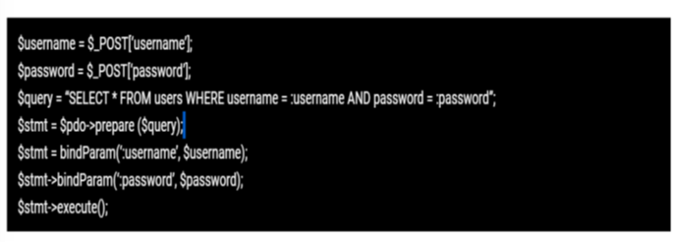

Slide 6
study cases
Equifax Data Breach -2017
Target Data Breach - 2013
SQL Slammer Worm - 2003

Slide 7
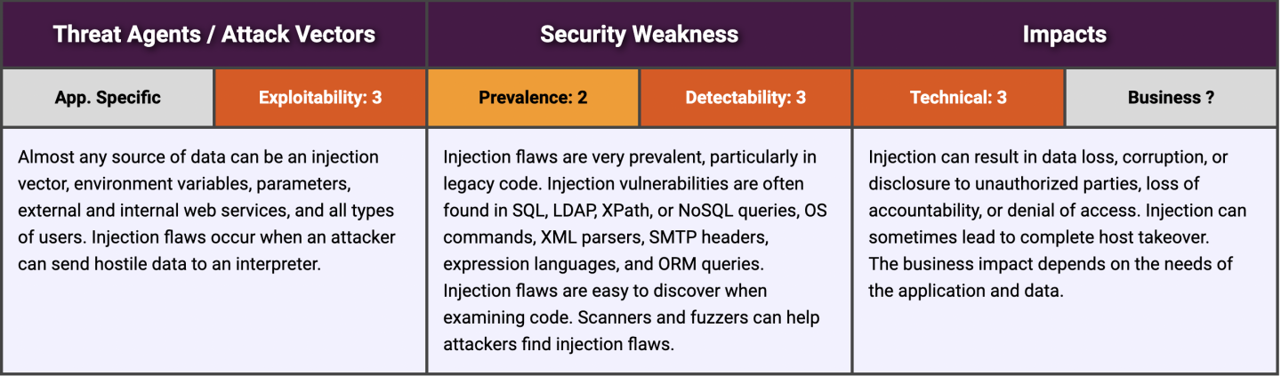

Slide 8
QUESTIONS? THANK YOU

